Slide 1
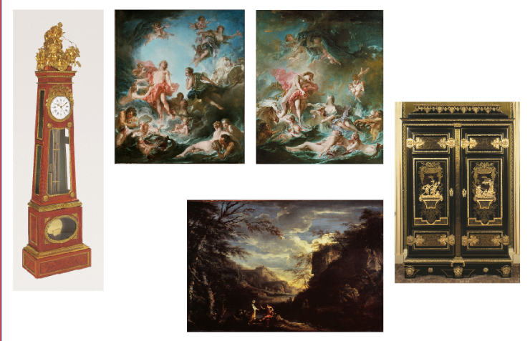
CLASSICAL MYTHS
APOLLO
KEY WORKS
Apollo was one of the Olympians, the major Greek gods, so called because they lived on Mount Olympus. God of the sun, music, medicine, prophecy and more, he and his twin sister Artemis were the children of Zeus by Leto, a mortal woman. Apollo is often depicted riding a chariot with white horses across the sky, representing the journey of the sun during the day. Sometimes he holds a small instrument called a lyre, to demonstrate his status as god of music and the arts. People travelled from all over the ancient Greek world to consult his oracle at Delphi in the belief that they could learn the future.

Slide 2
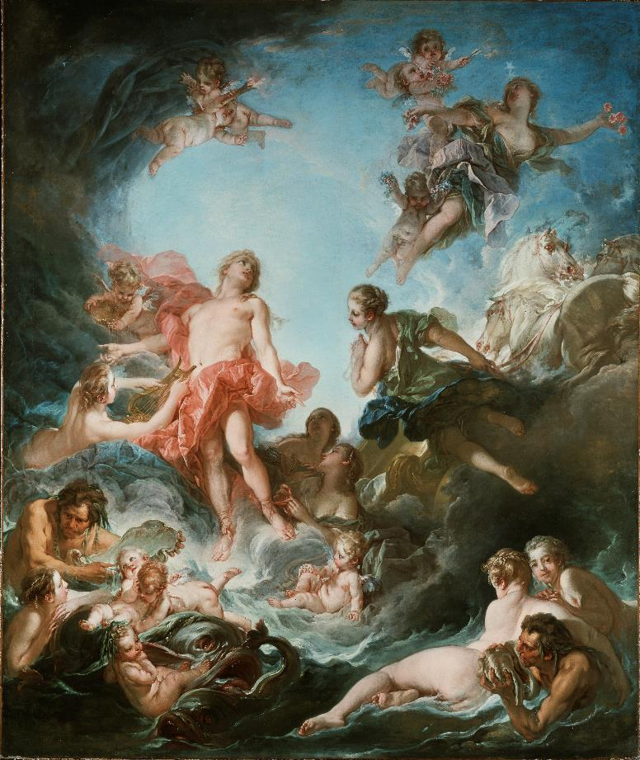
CLASSICAL MYTHS
^{THE RISING OF THE SUN}
APOLLO
^{TITLE}
^{DATE}
^{SIZE}
^{MATERIALS}
^{ARTIST}
^{ARTIST’S DATES}
^{PLACE}
^{The Rising of the Sun}
¹⁷⁵³
^{318 x 261 cm}
^{Oil on canvas}
^{François Boucher}
¹⁷⁰³ ⁻ ¹⁷⁷⁰
^{France}

Slide 3
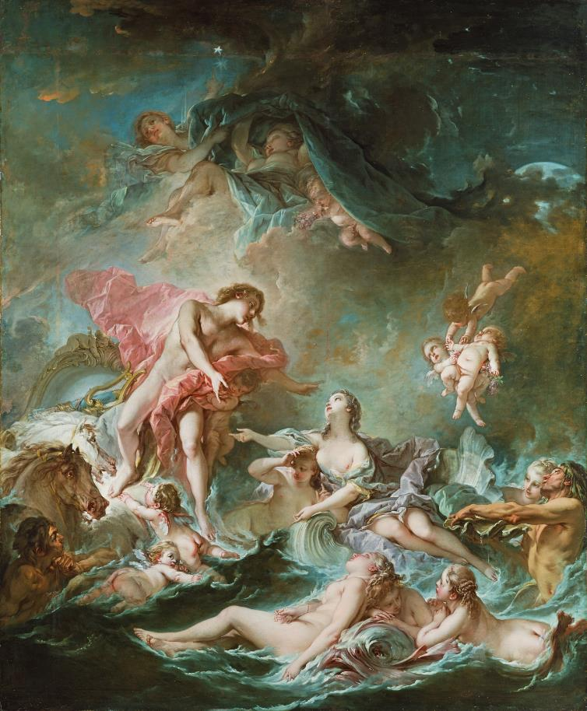
CLASSICAL MYTHS
^{THE SETTING OF THE SUN}
APOLLO
^{TITLE}
^{DATE}
^{SIZE}
^{MATERIALS}
^{ARTIST}
^{ARTIST’S DATES}
^{PLACE}
^{The Setting of the Sun}
¹⁷⁵²
^{318 x 261 cm}
^{Oil on canvas}
^{François Boucher}
¹⁷⁰³ ⁻ ¹⁷⁷⁰
^{France}

Slide 4
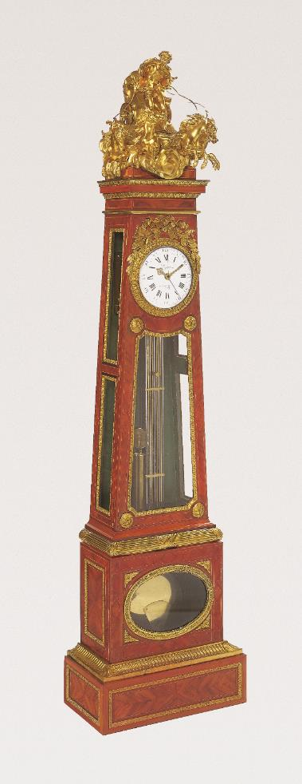
CLASSICAL MYTHS
LONG CASE CLOCK WITH APOLLO AND CHARIOT
APOLLO
^{TITLE}
^{DATE}
^{SIZE}
^{MATERIALS}
^{MAKERS}
^{PLACE}
Long Case Clock with Apollo and Chariot
^{c.1780}
^{221.2 x 56.8 x 34.5 cm}
^{Oak, pine;}
^{veneers of tulipwood, satiné}
^{stringings of ebony and box;}
glass, gilt bronze, brass and steel
^{Nicolas Petit : Case Maker}
Jacques-Joseph Lepaute : Movement Maker
^{Elie Barbezat : Dial Enameller}
Mounts cast after Philippe Caffiéri
^{France}

Slide 5
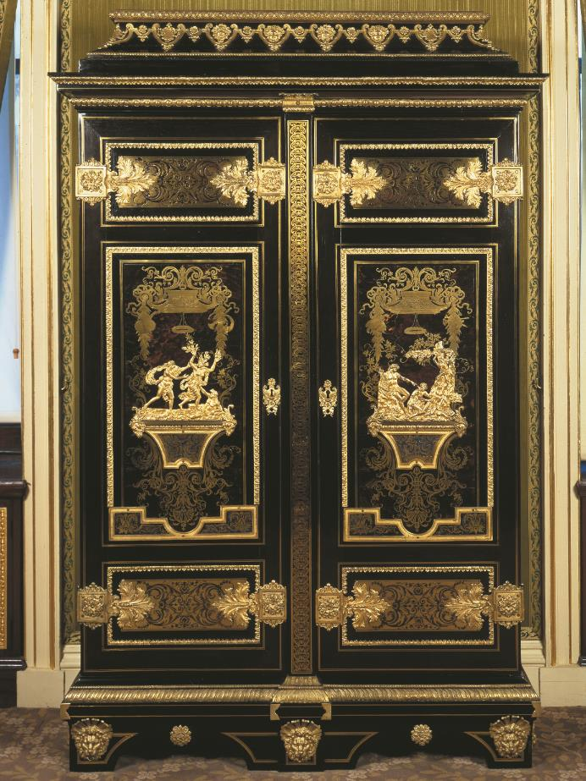
CLASSICAL MYTHS
WARDROBE WITH APOLLO AND DAPHNE
APOLLO
^{TITLE}
^{DATE}
^{SIZE}
^{MATERIALS}
^{MAKERS}
^{DATES}
^{PLACE}
Wardrobe with Apollo and Daphne
^{c.1700}
^{255 x 163.5 x 61 cm}
^{Oak, ebony,}
marquetry of brass and turtleshell,
^{marquetry (inside doors) of:}
^{ebony, amaranth and pewter,}
gilt bronze, steel lock, bolts and key
Attributed to André-Charles Boulle,
¹⁶⁴² ⁻ ¹⁷³²
^{France}

Slide 6
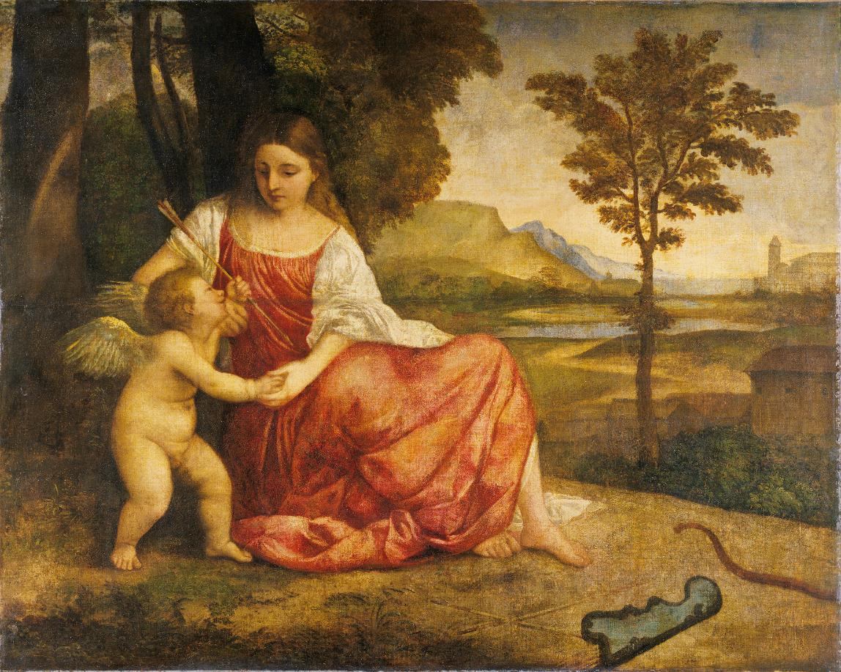
CLASSICAL MYTHS
^{VENUS AND CUPID}
APOLLO
^{TITLE}
^{DATE}
^{SIZE}
^{MATERIALS}
^{ARTIST}
^{ARTIST’S DATES}
^{PLACE}
^{Venus and Cupid}
^{c.1510-1515}
^{110.5 x 138.4 cm}
^{Oil on canvas}
^{Attributed to Titian}
¹⁴⁸⁵ ⁻ ¹⁵⁷⁶
^{Italy}

Slide 7
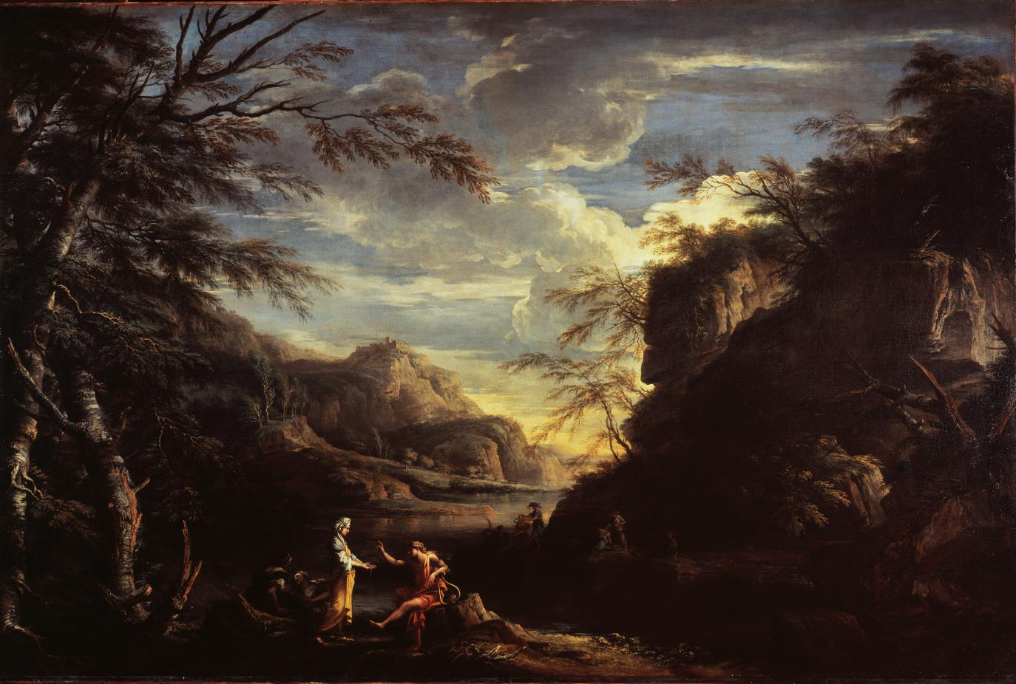
CLASSICAL MYTHS
^{APOLLO AND THE CUMAEAN SIBYL}
APOLLO
^{TITLE}
^{DATE}
^{SIZE}
^{MATERIALS}
^{ARTIST}
^{ARTIST’S DATES}
^{PLACE}
River Landscape with Apollo and the Cumaean Sibyl
¹⁶⁵⁷⁻⁵⁸
^{173.7 x 259.5 cm}
^{Oil on canvas}
^{Salvator Rosa}
¹⁴⁸⁵ ⁻ ¹⁵⁷⁶
^{Italy}

Slide 8
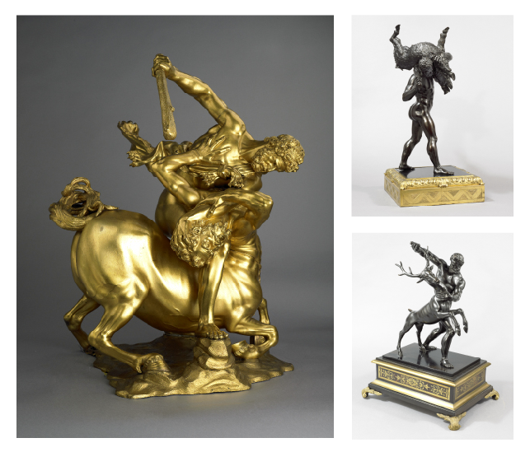
CLASSICAL MYTHS
HERCULES
KEY WORKS
Hercules is considered a ‘hero’ rather than a god, as he was the son of Jupiter and Alcmene, a mortal woman.
Hercules is usually depicted as having a very powerful body, short hair and a beard, and is cloaked with a lion skin. Hercules has long been a favourite subject for artists and especially sculptors.
A small collection of bronzes showing some of the adventures and the Twelve Labours of Hercules is displayed in the Great Gallery at the Wallace Collection

Slide 9
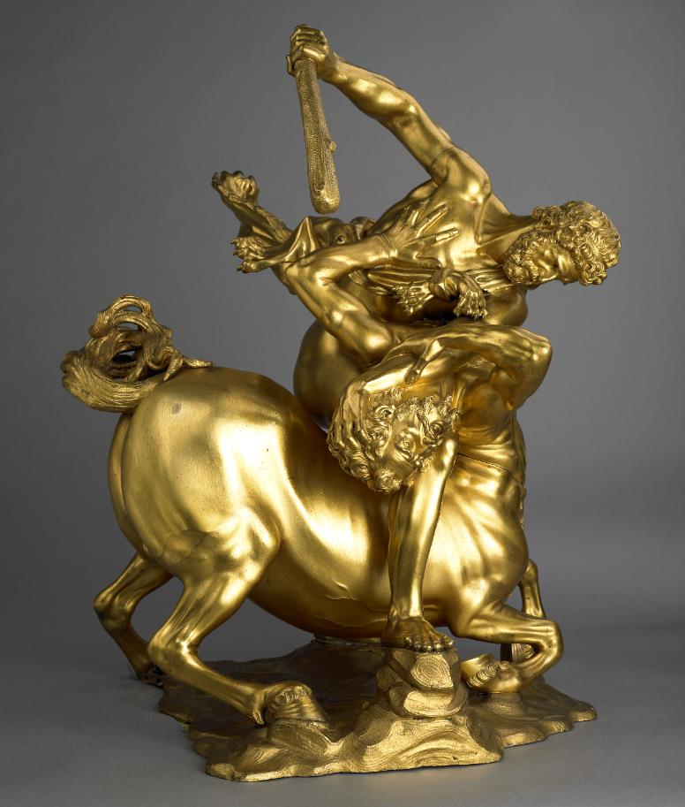
CLASSICAL MYTHS
HERCULES OVERCOMING THE CENTAUR
HERCULES
^{TITLE}
^{DATE}
^{SIZE}
^{MATERIALS}
^{MAKERS}
^{PLACE}
Hercules Overcoming the Centaur Eurytion
^{c.1640-50}
^{Height: 67 cm, Width: 44 cm}
^{Bronze copper alloy, gilded}
Cast by Ferdinando Tacca (1619 - 1686)
Model designed by Pietro Tacca (1577 - 1640)
After original models by Giambologna (1524 - 1608)
^{Italy}

Slide 10
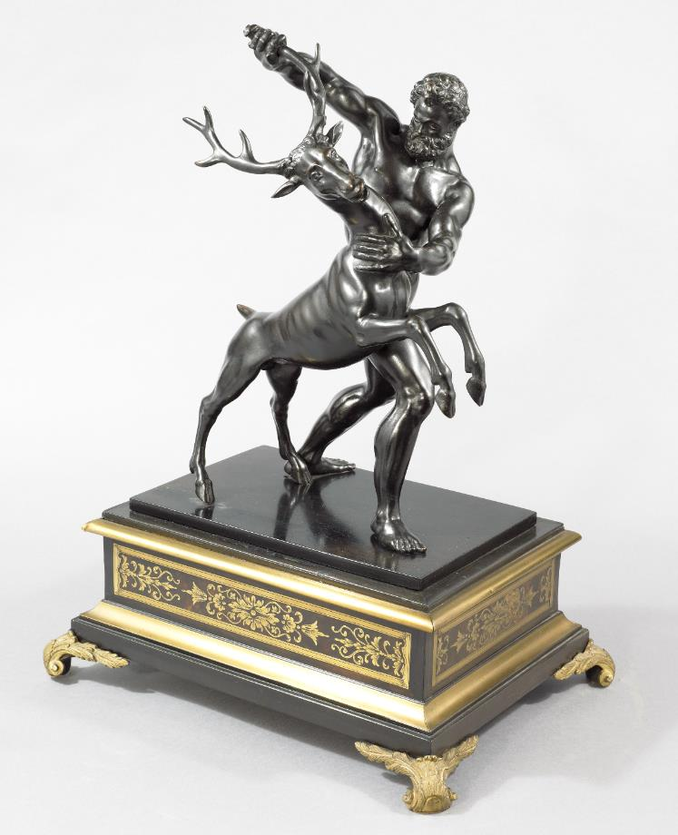
CLASSICAL MYTHS
HERCULES AND THE CERYNITIAN STAG
HERCULES
^{TITLE}
^{DATE}
^{SIZE}
^{MATERIALS}
^{MAKER}
^{DATES}
^{PLACE}
Hercules and the Cerynitian Stag
^{Original model 1570s;}
^{cast 17thC. or 18thC.}
^{Height: 36.5 cm}
^{Bronze copper alloy}
^{Unknown, After Giambologna}
¹⁵²⁴ ⁻ ¹⁶⁰⁸
^{Italy}

Slide 11
CLASSICAL MYTHS
HERCULES CARRYING OFF THE ERYMANTHIAN BOAR
HERCULES
^{TITLE}
^{DATE}
^{SIZE}
^{MATERIALS}
^{MAKER}
^{DATES}
^{PLACE}
Hercules carrying off the Erymanthian Boar
^{Original model 1570s;}
^{cast 17thC. or 18thC.}
^{Height: 45.2 cm}
^{Bronze copper alloy}
^{Unknown, After Giambologna}
¹⁵²⁴ ⁻ ¹⁶⁰⁸
^{Italy}

Slide 12
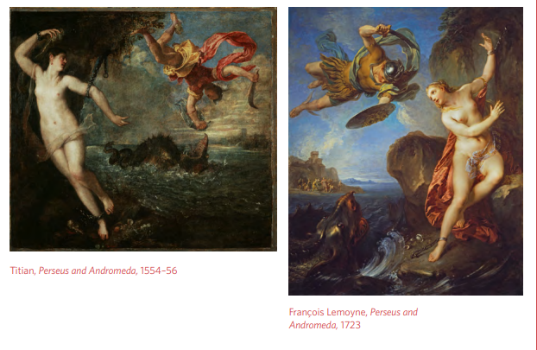
CLASSICAL MYTHS
PERSEUS AND ANDROMEDA
KEY WORKS
Another popular hero in Greek mythology was Perseus – the son of Jupiter by a mortal woman (and actually a half-brother to Hercules). He is distinguished by his armour – a winged helmet, wings on his sandals, a sword and polished shield. This shield was given to him by Minerva, goddess of wisdom. The wings on his sandals and helmet enabled him to fly.

Slide 13
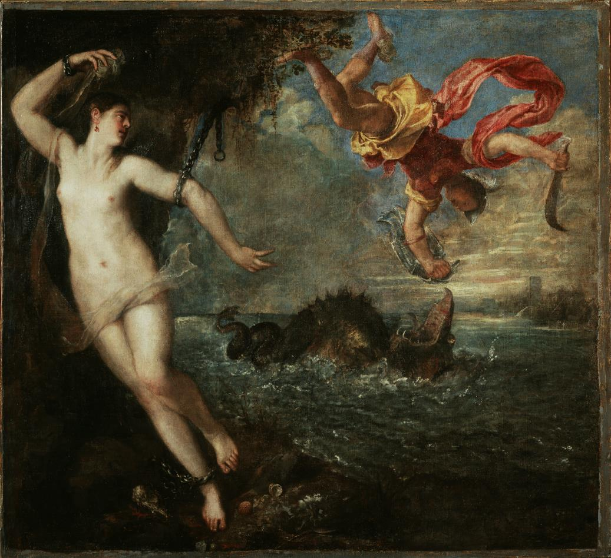
CLASSICAL MYTHS
^{PERSEUS AND ANDROMEDA}
PERSEUS AND ANDROMEDA
^{TITLE}
^{DATE}
^{SIZE}
^{MATERIALS}
^{ARTIST}
^{DATES}
^{PLACE}
^{Perseus and Andromeda}
¹⁵⁵⁴⁻⁵⁶
^{183.3 x 199.3 cm}
^{Oil on canvas}
^{Titian}
¹⁴⁸⁵ ⁻ ¹⁵⁷⁶
^{Italy}

Slide 14
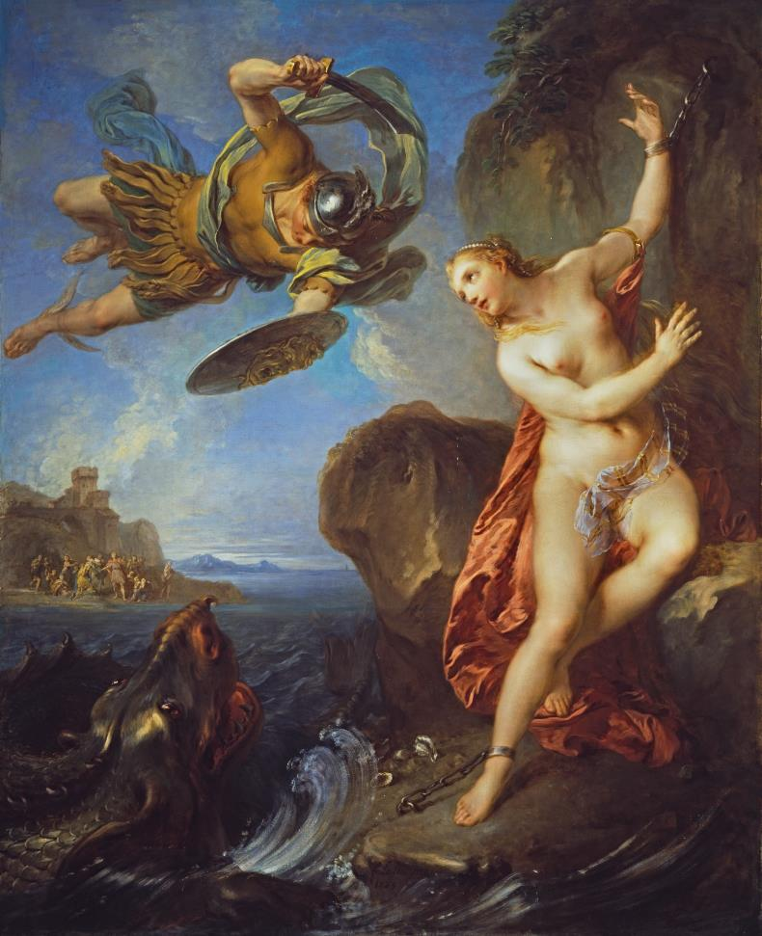
CLASSICAL MYTHS
^{PERSEUS AND ANDROMEDA}
PERSEUS AND ANDROMEDA
^{TITLE}
^{DATE}
^{SIZE}
^{MATERIALS}
^{ARTIST}
^{DATES}
^{PLACE}
^{Perseus and Andromeda}
¹⁷²³
^{183 x 149.7 cm}
^{Oil on canvas}
^{François Lemoyne}
^{1688–1737}
^{France}

Slide 15
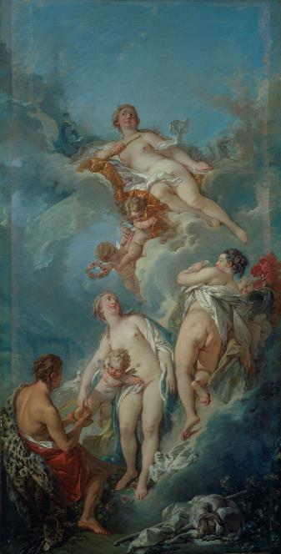
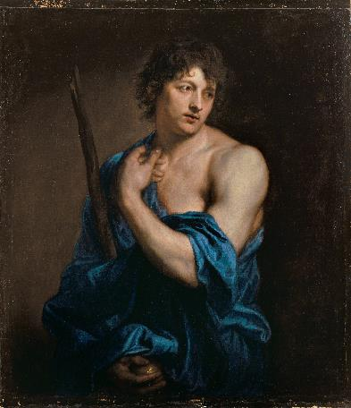
CLASSICAL MYTHS
PARIS
KEY WORKS
The subject of these paintings is the events that started one of the most famous legendary conflicts, the Trojan War. The gods were at a party celebrating a wedding, when suddenly a golden apple was thrown into their midst. It was thrown by the goddess of Discord, who was angered by not being invited. The apple bore the words ‘For the Fairest’, and was deliberately placed to start an argument. Unable to decide who was the fairest, three powerful goddesses approached Paris, the son of King Priam of Troy.

Slide 16

CLASSICAL MYTHS
^{THE JUDGMENT OF PARIS}
PARIS
^{TITLE}
^{DATE}
^{SIZE}
^{MATERIALS}
^{ARTIST}
^{DATES}
^{PLACE}
^{The Judgment of Paris}
¹⁷⁵⁴
^{164 x 76.6cm}
^{Oil on canvas}
^{François Boucher}
¹⁷⁰³ ⁻ ¹⁷⁷⁰
^{France}

Slide 17

CLASSICAL MYTHS
^{PARIS}
PARIS
^{TITLE}
^{DATE}
^{SIZE}
^{MATERIALS}
^{ARTIST}
^{DATES}
^{PLACE}
^{Paris}
¹⁶²⁸
^{96 x 84 cm}
^{Oil on canvas}
^{Anthony Van Dyck}
¹⁵⁹⁹ ⁻ ¹⁶⁴¹
^{The Netherlands}

