Slide 1
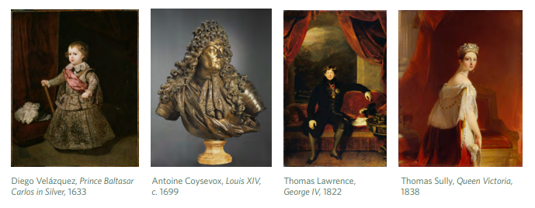
PORTRAITURE
POWER AND ROYALTY
KEY WORKS

Slide 2
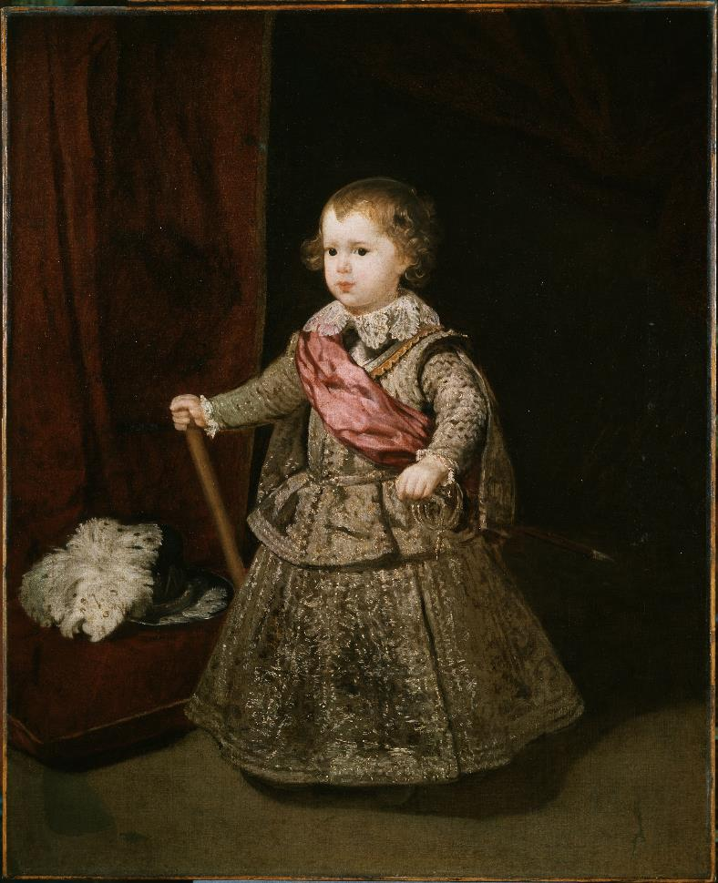
Title: Prince Baltasar Carlos in Silver
Date: 1633
Size: 117.8 x 95.9 cm
Materials: Oil on canvas
Artist: Diego Velázquez
Dates: 1599–1660
Place: Spain

Slide 3
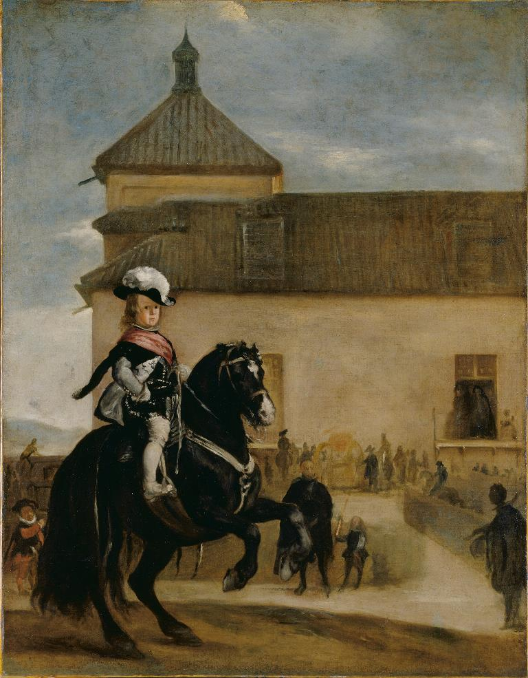
Studio of Diego Velázquez (1599–1660), Prince Baltasar Carlos in the Riding School, c. 1640–45

Slide 4
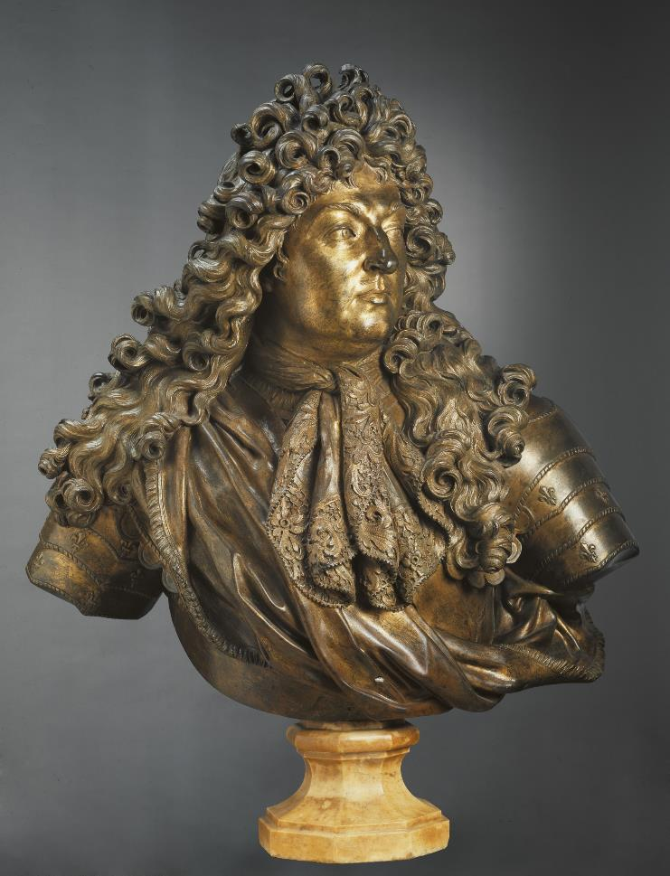
Title: Louis XIV
Date: c. 1699
Size: 74.9 x 71.8 cm
Materials: Bronze, originally gilded
Artist: Antoine Coysevox
Dates: 1640–1720
Place: France

Slide 5
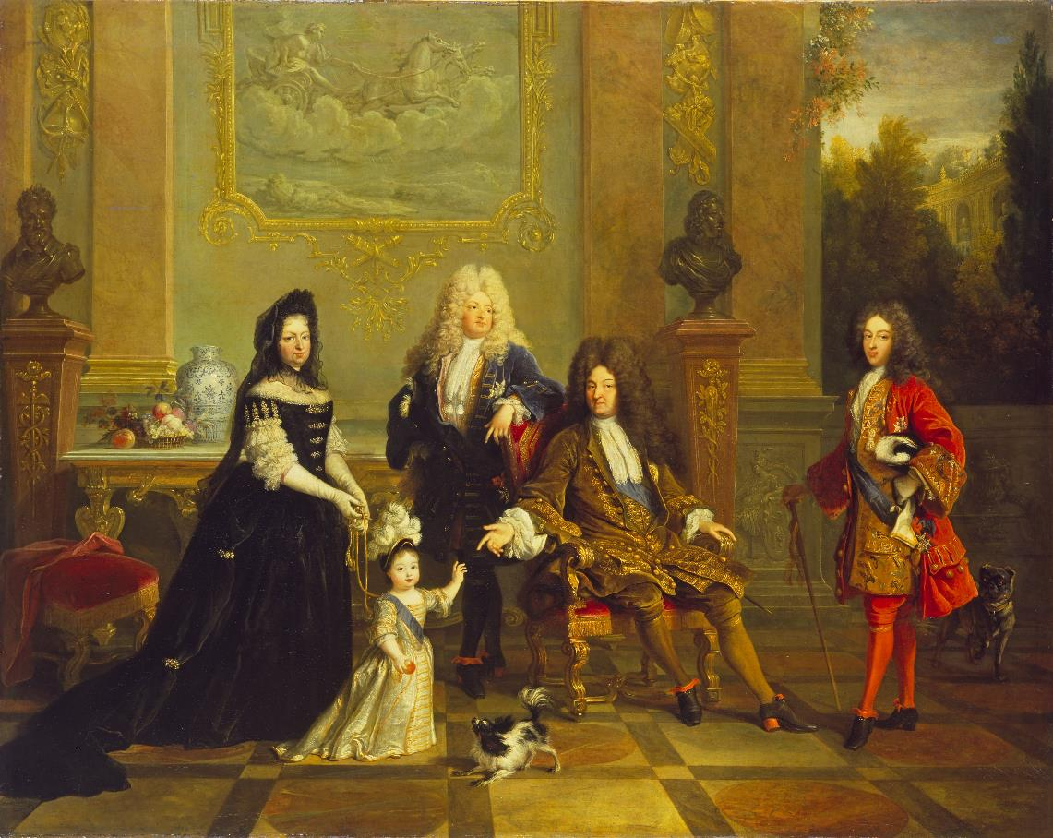
French School,
Madame de Ventadour with Louis XIV and his Heirs, 1715–1720

Slide 6
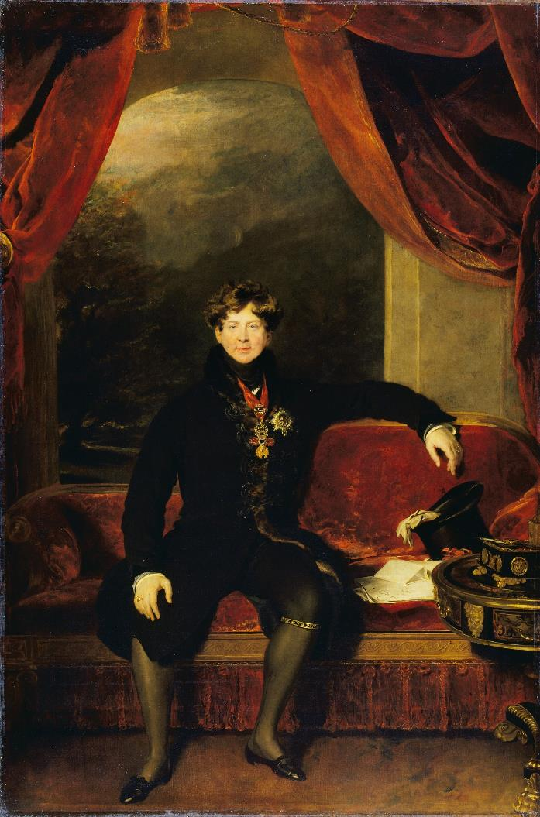
Title: George IV
Date: 1822
Size: 270.5 x 179 cm
Materials: Oil on canvas
Artist: Thomas Lawrence
Dates: 1769–1830
Place: England

Slide 7
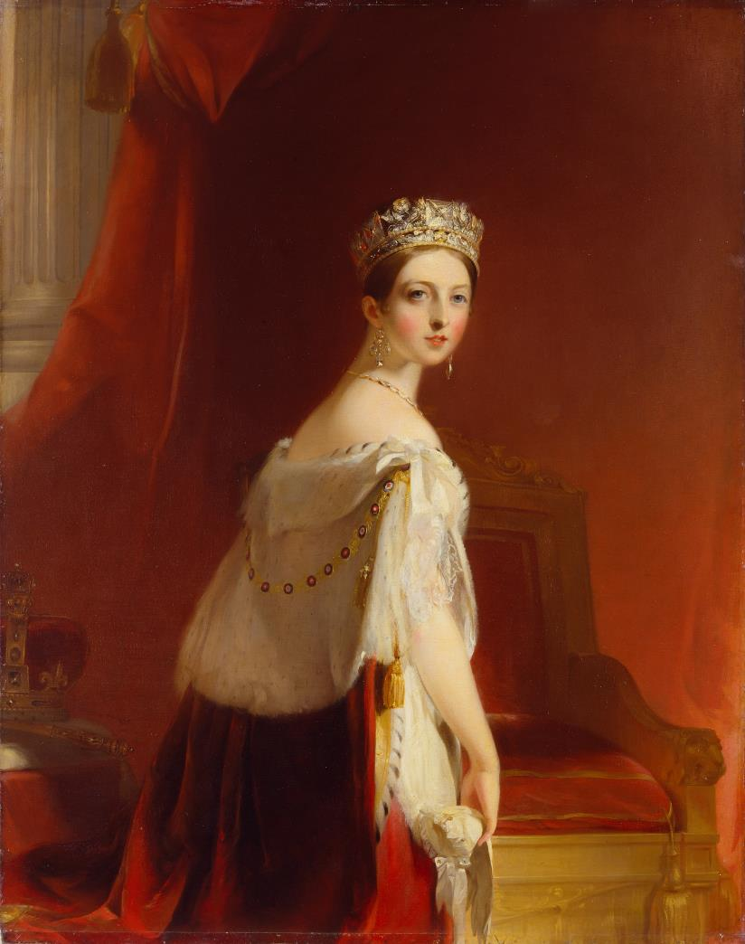
Title: Queen Victoria
Date: 1838
Size: 142.5 x 112.5 cm
Materials: Oil on canvas
Artist: Thomas Sully
Dates: 1783–1872
Place: England

Slide 8
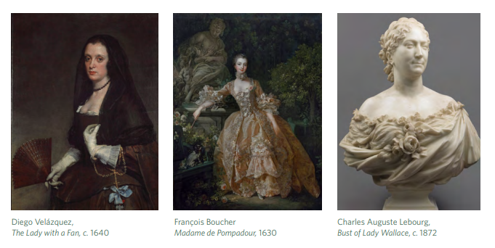
PORTRAITURE
FAME AND CELEBRITY
KEY WORKS

Slide 9
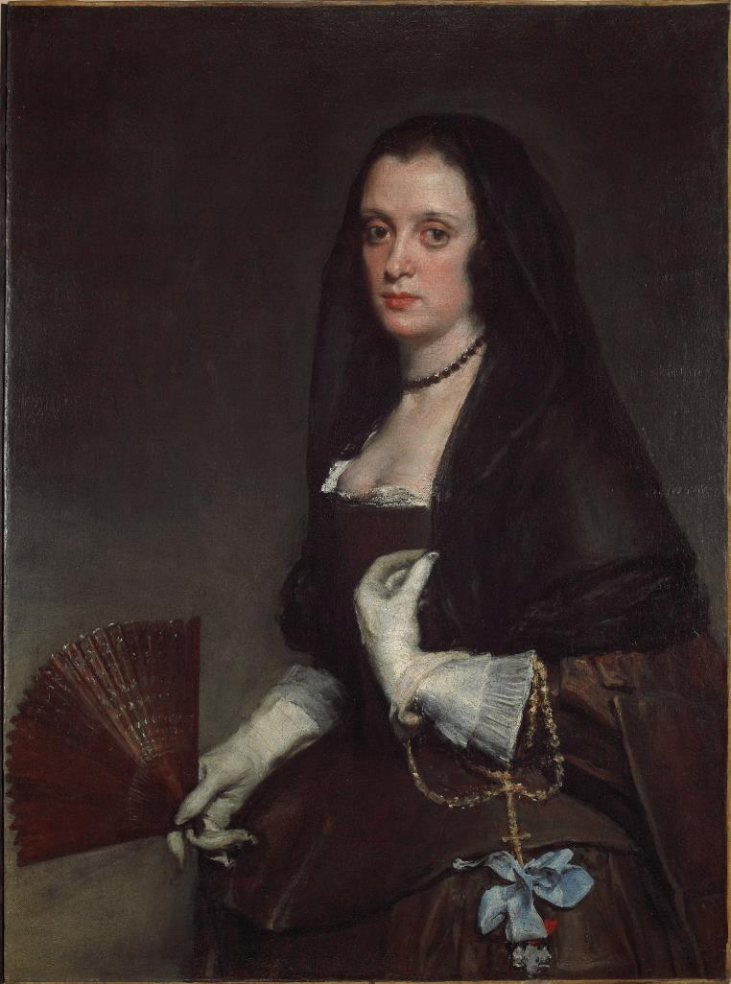
Title: The Lady with a Fan
Date: c. 1640
Size: 95 x 70 cm
Materials: Oil on canvas
Artist: Diego Velázquez
Dates: 1599–1660
Place: Spain

Slide 10
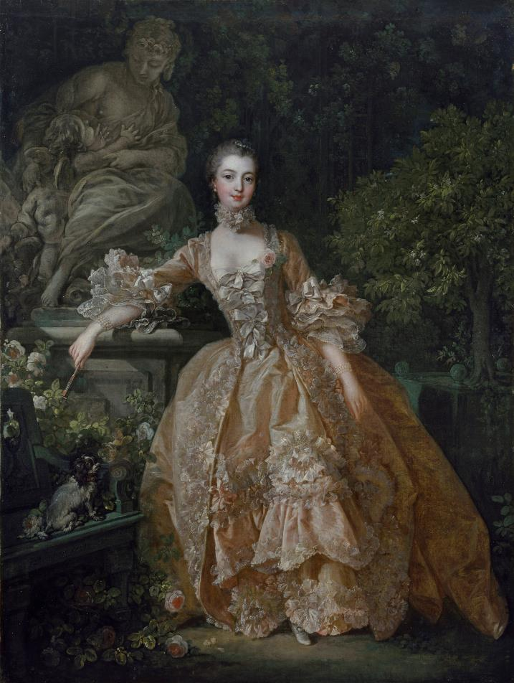
Title: Madame de Pompadour
Date: 1759
Size: 91 x 68 cm
Materials: Oil on canvas
Artist: François Boucher
Dates: 1703–1770
Place: France

Slide 11
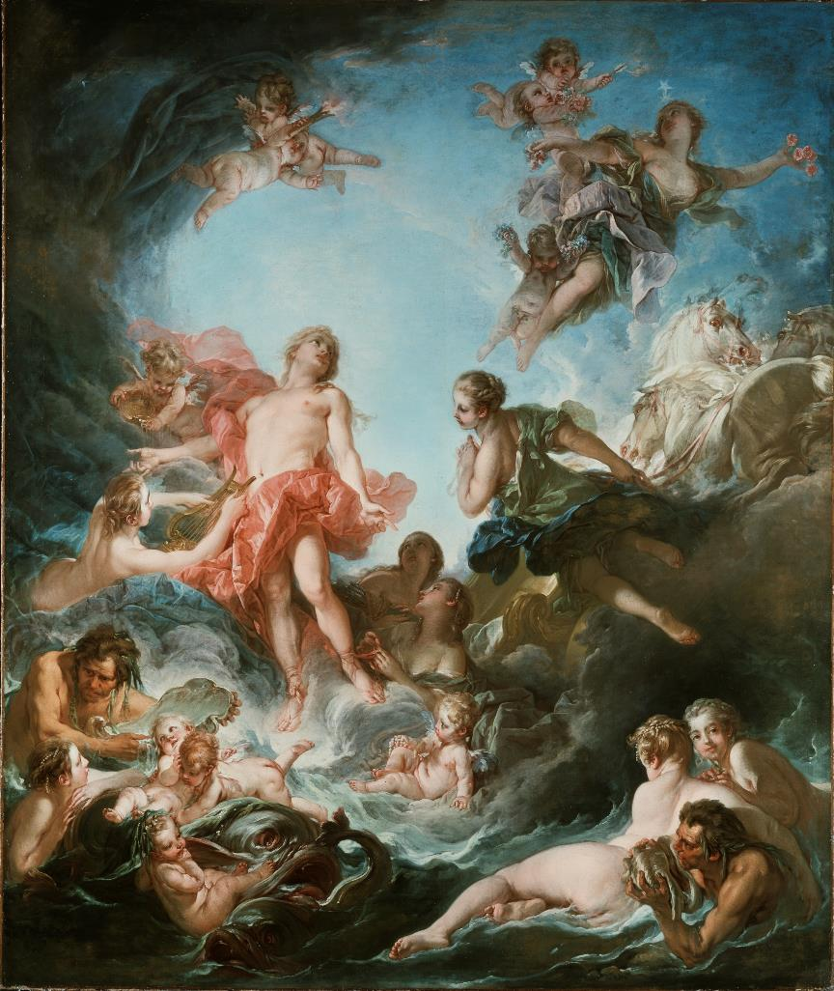
^{Title: The Rising of the Sun}
^{Date: 1753}
^{Size: 318 x 261 cm}
^{Materials: Oil on canvas}
^{Artist: François Boucher}
^{Dates: 1703 - 1770}
^{Place: France}

Slide 12
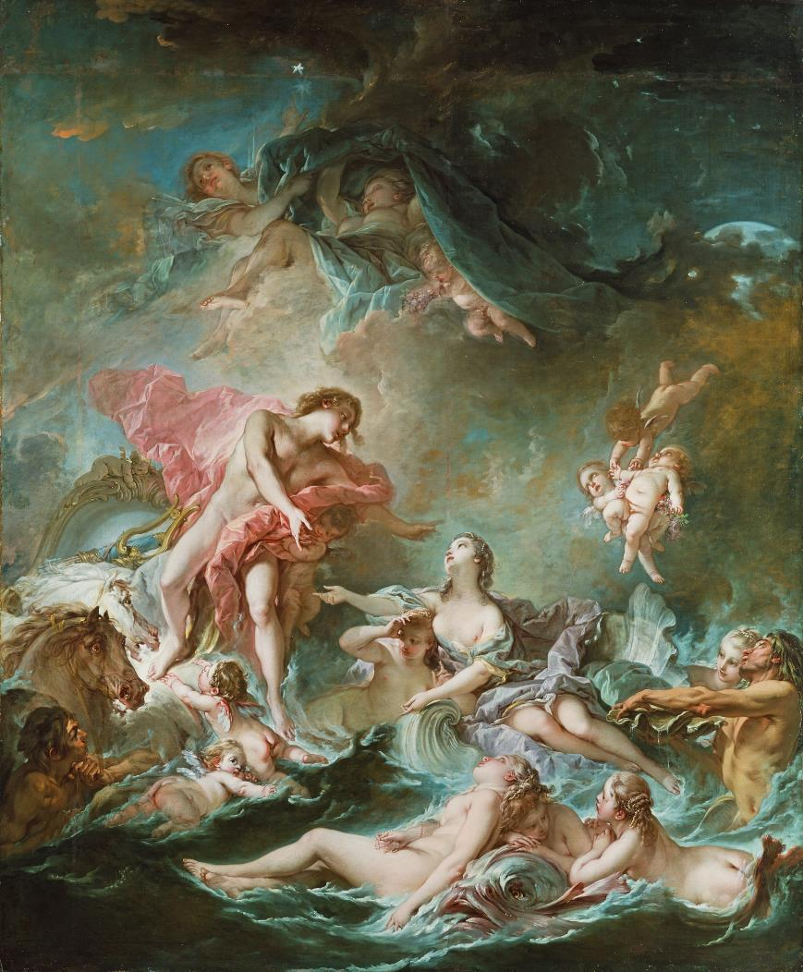
^{Title: The Setting of the Sun}
^{Date: 1752}
^{Size: 318 x 261 cm}
^{Materials: Oil on canvas}
^{Artist: François Boucher}
^{Dates: 1703 - 1770}
^{Place: France}

Slide 13
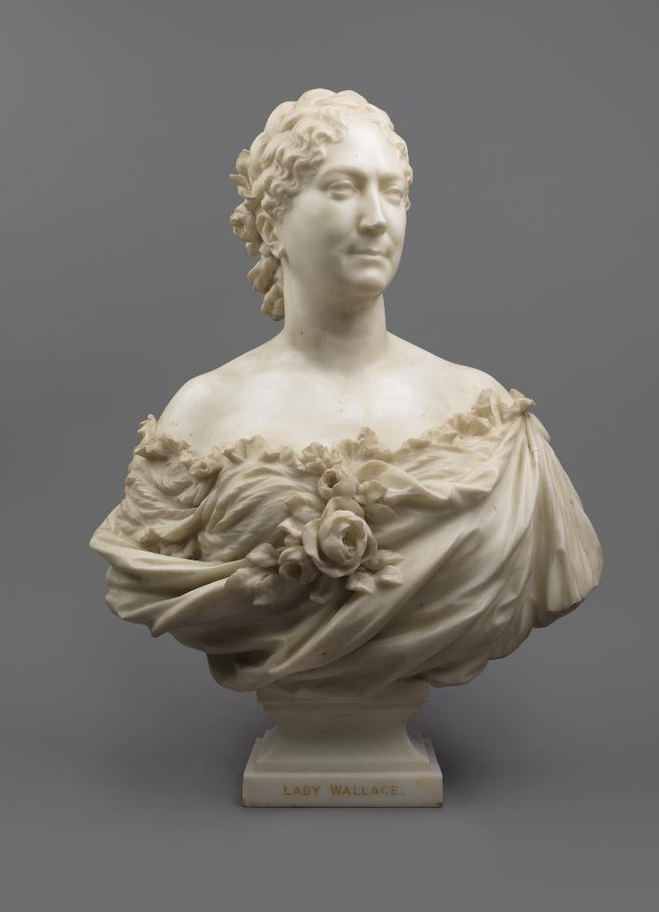
Title: Bust of Lady Wallace
Date: c. 1872
Height: 71 cm
Material: Marble
Artist: Charles Auguste Lebourg
Dates: 1829–1906
Place: France

Slide 14
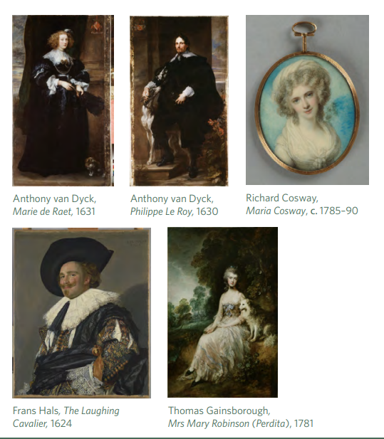
PORTRAITURE
LOVE, MARRIAGE AND LOYALTY
KEY WORKS

Slide 15
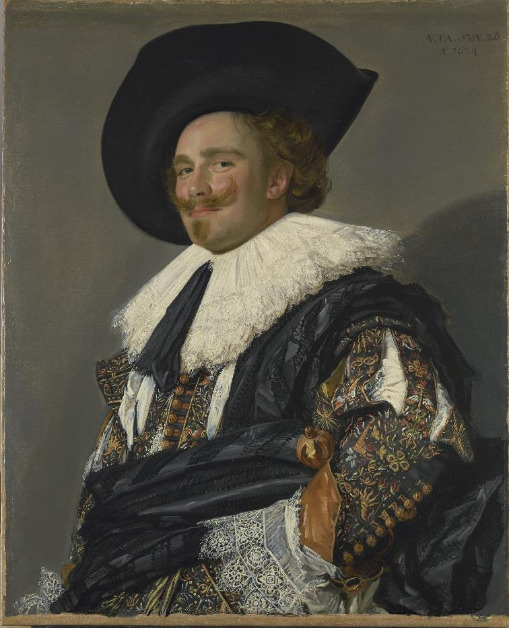
Title: The Laughing Cavalier
Date: 1624
Size: 83 x 67.3 cm
Materials: Oil on canvas
Artist: Frans Hals
Dates: 1582/3–1666
Place: The Netherlands

Slide 16
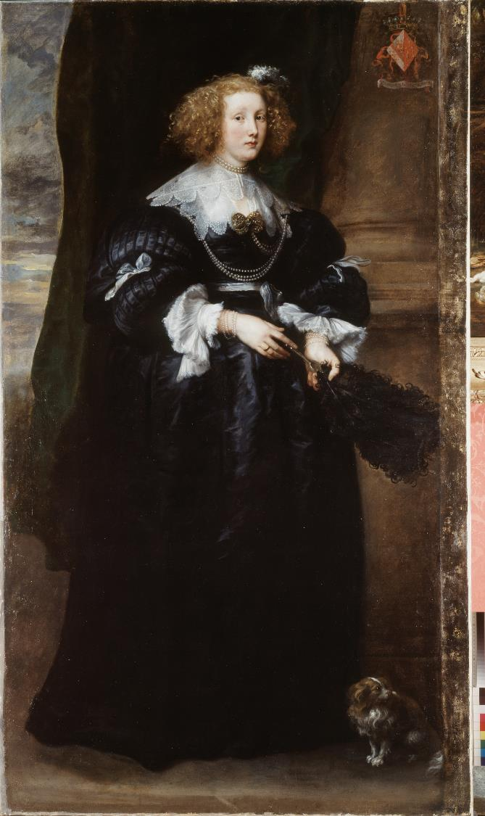
Title: Marie de Raet
Date: 1631
Size: 213.3 x 114.5 cm
Materials: Oil on canvas
Artist: Anthony van Dyck
Dates: 1599–1641
Place: Southern Netherlands

Slide 17
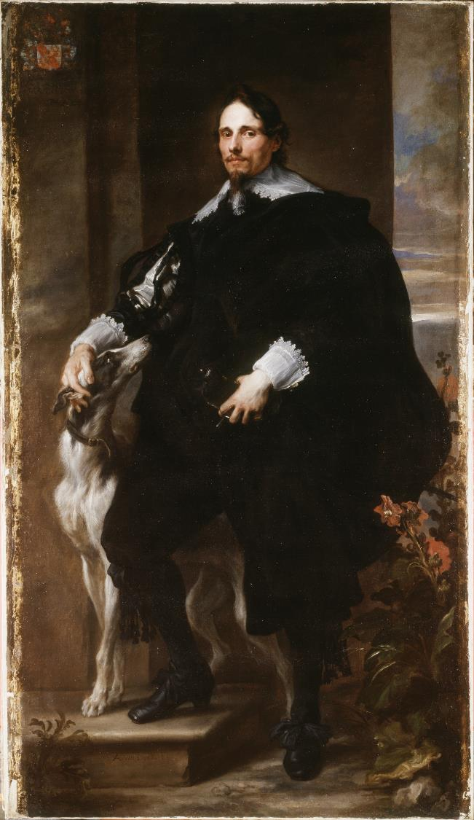
Title: Philippe Le Roy
Date: 1630
Size: 213.3 x 114.5 cm
Materials: Oil on canvas
Artist: Anthony van Dyck
Dates: 1599–1641
Place: Southern Netherlands

Slide 18
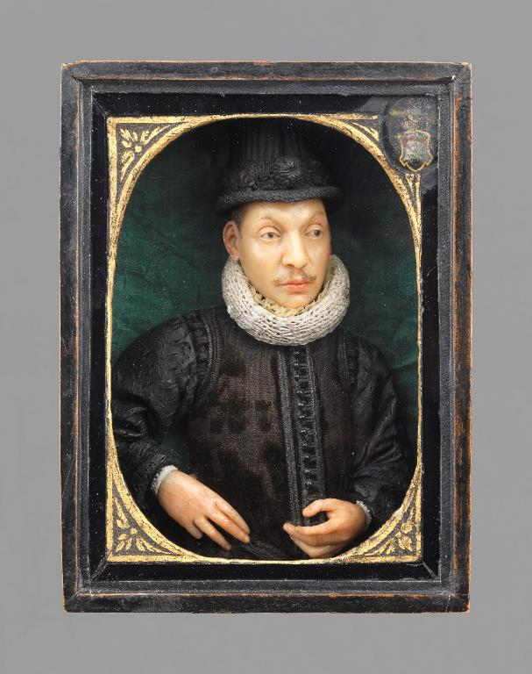
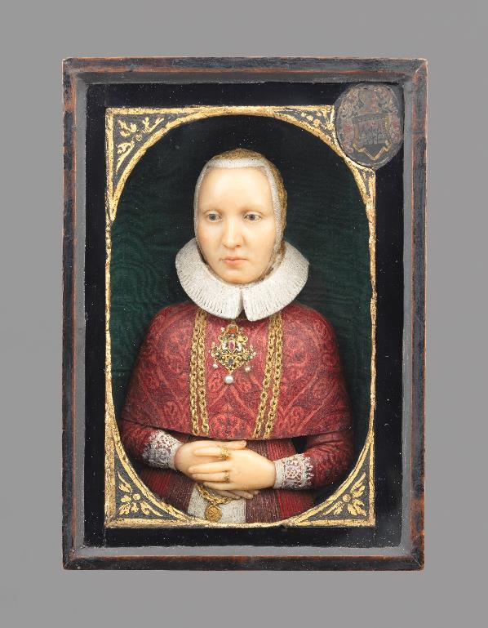
Portrait of a Gentleman
Early 17th Century
Artist unknown
Northern Germany
Materials: Wax, painted and gilded, silk, wood, glass
Size: 15.2 x 10.8 cm
Portrait of a Lady
Early 17th Century
Artist unknown
Northern Germany

Slide 19
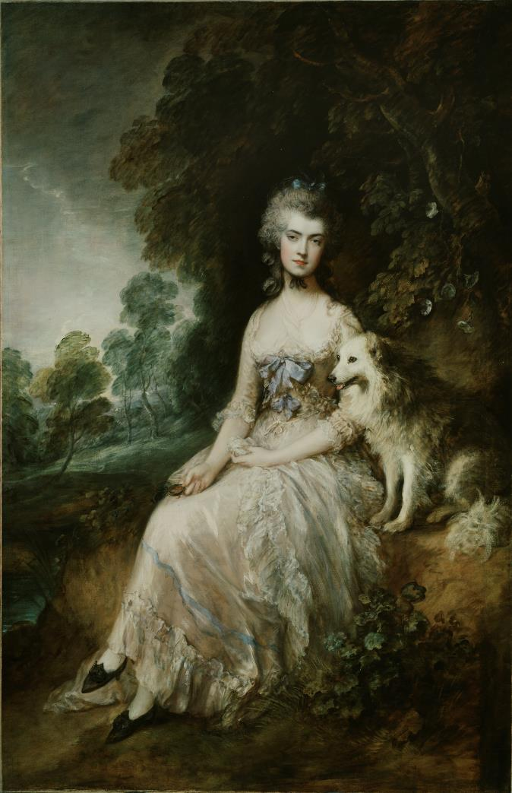
Title: Mrs Mary Robinson (Perdita)
Date: 1781
Size: 233.7 x 153 cm
Materials: Oil on canvas
Artist: Thomas Gainsborough
Dates: 1727–1788
Place: England

Slide 20
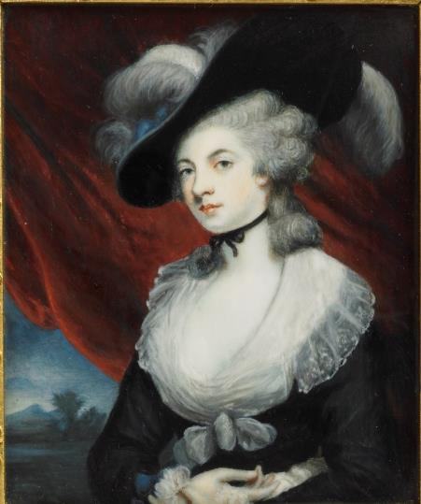
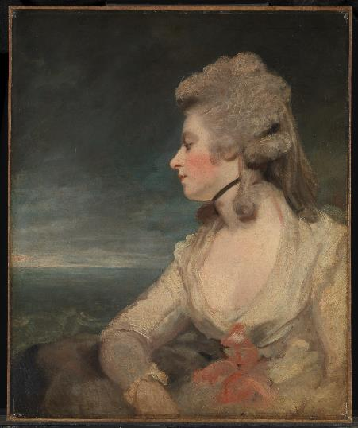
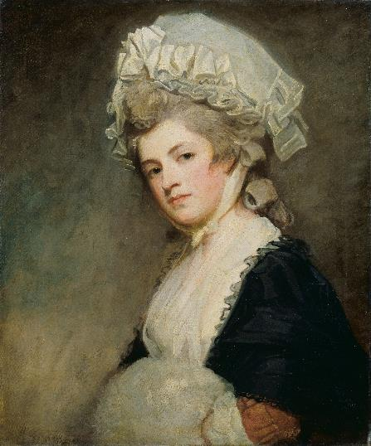
John Hazlitt
Mrs ‘Perdita’ Robinson, after Reynolds
c. 1790–c. 1830
Joshua Reynolds
Mrs Mary Robinson
1783–1784
George Romney
Mrs Mary Robinson
1780–1781

Slide 21
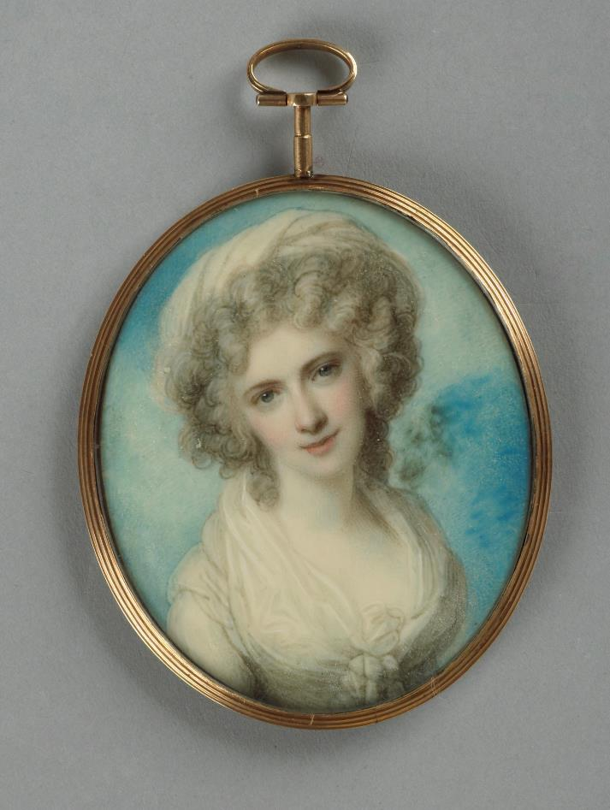
Title: Maria Cosway
Date: c. 1785–90
Size: 7.1 x 5.8 cm
Materials: Painted on ivory
Artist: Richard Cosway
Dates: 1742–1821
Place: England

Slide 22
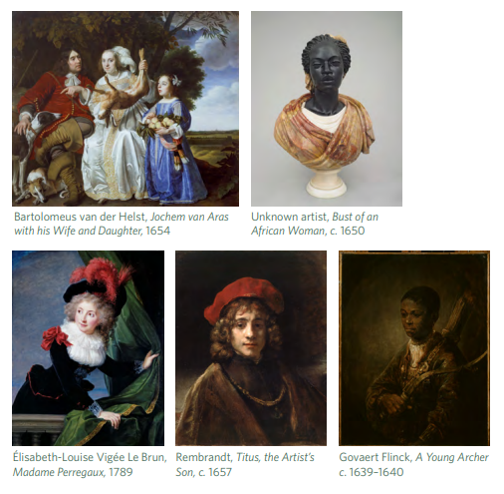
PORTRAITURE
PEOPLE AND FACES
KEY WORKS

Slide 23
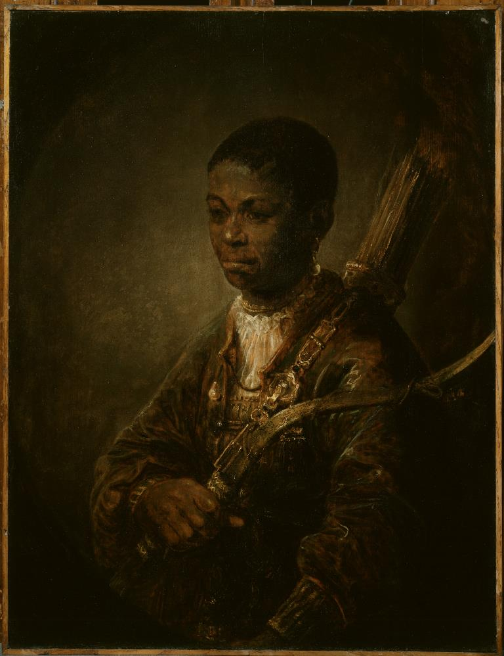
Title: A Young Archer
Date: c. 1639–1640
Size: 66.2 x 50.8 cm
Materials: Oil on oak panel
Artist: Govaert Flinck
Dates: 1615–1660
Place: The Netherlands

Slide 24
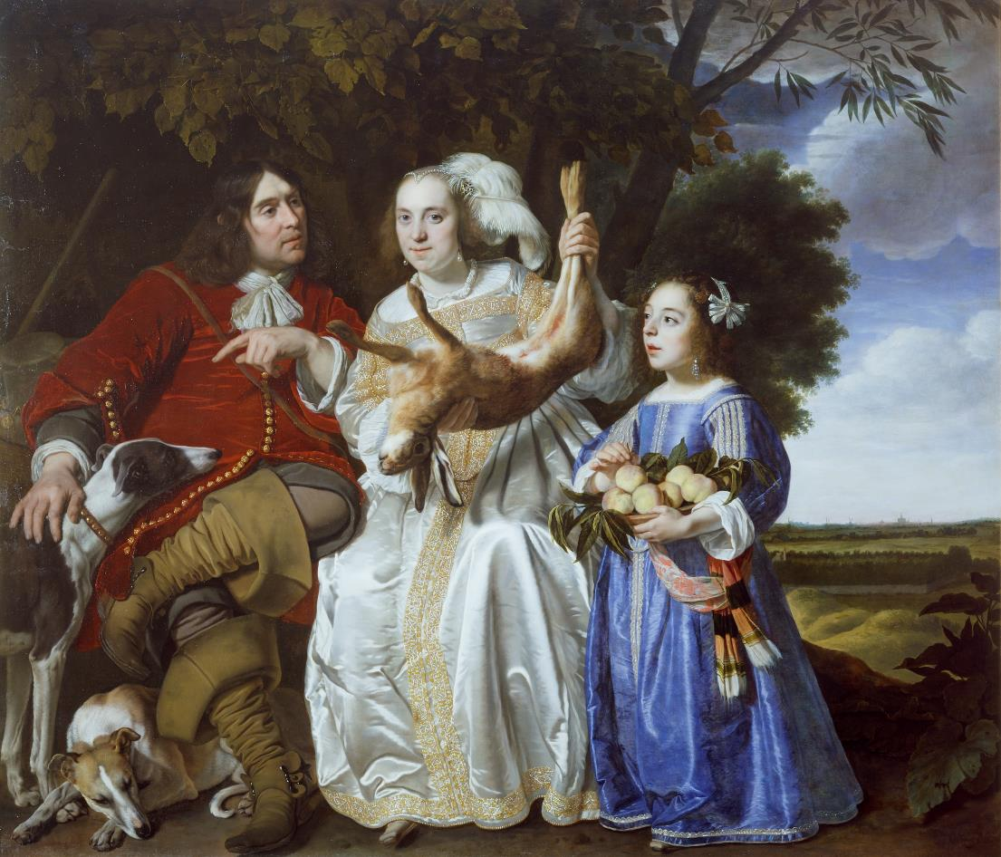
Title: Jochem van Aras with his Wife and Daughter
Date: 1654
Size: 169.5 x 197.2 cm
Materials: Oil on canvas
Artist: Bartolomeus van der Helst
Dates: 1613–1670
Place: The Netherlands

Slide 25
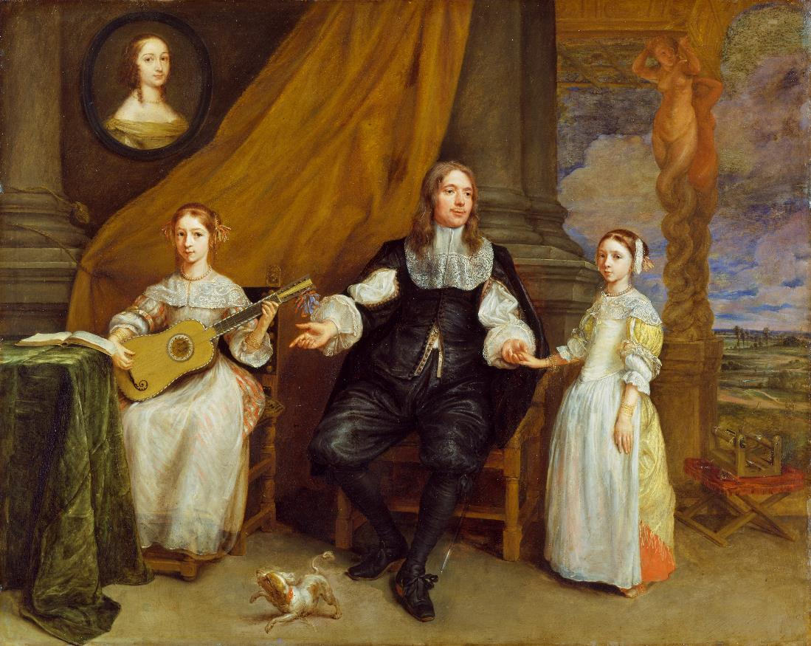
Gonzales Coques,
A Gentleman with his two Daughters, c. 1664

Slide 26
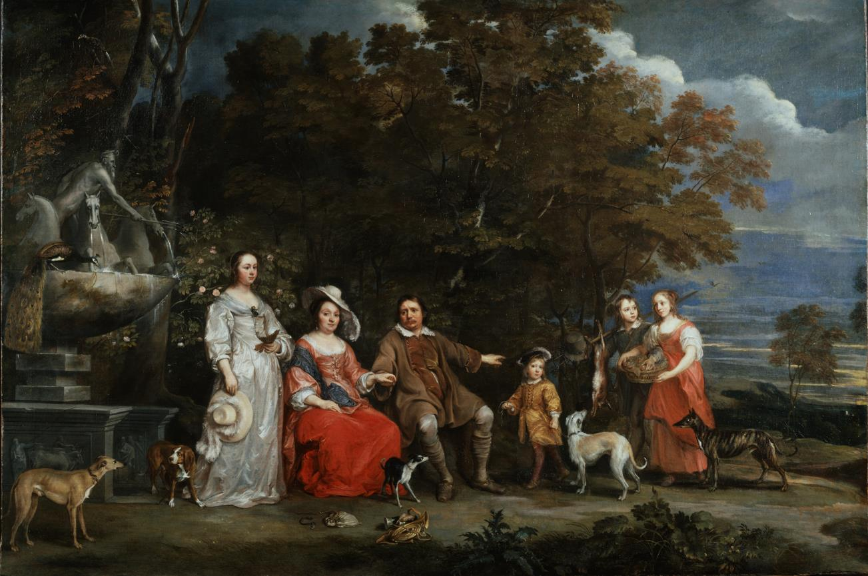
Gonzales Coques,
A Family Group by a Fountain, c. 1655–1660

Slide 27
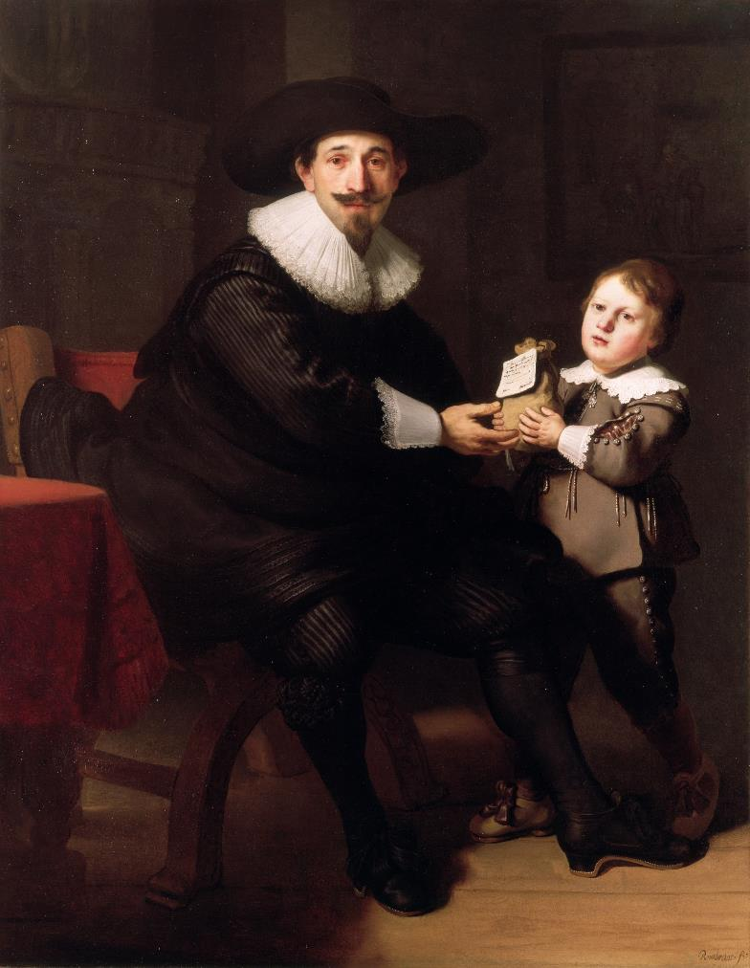
Rembrandt and Studio, Jean Pellicorne with his Son Caspar, c. 1632

Slide 28
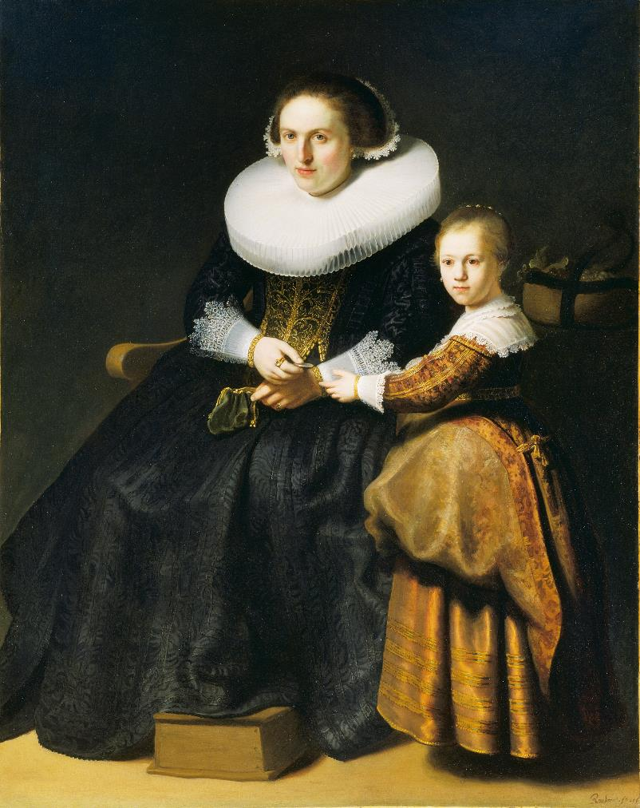
Rembrandt and Studio, Susanna van Collen, Wife of Jean Pellicorne with her Daughter Anna, c. 1632

Slide 29
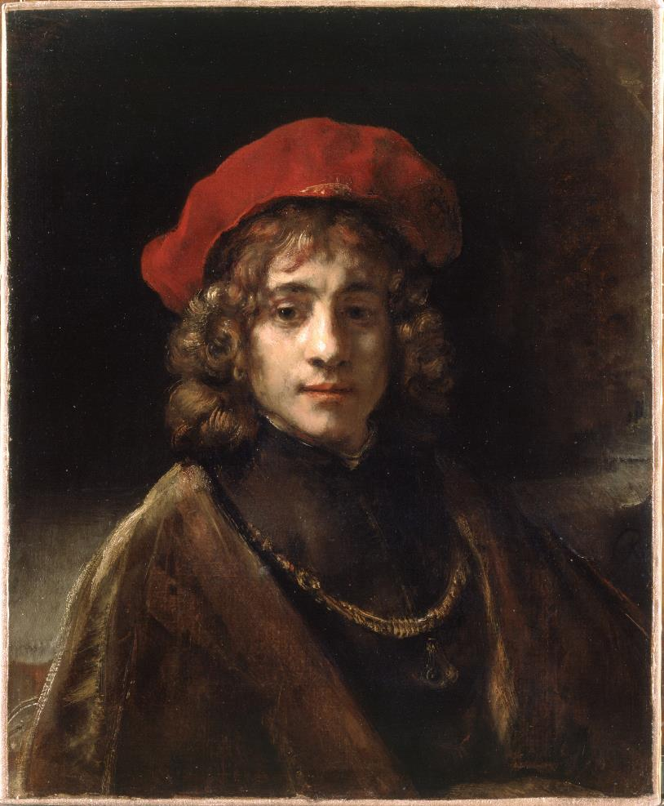
Title: Titus, the Artist's Son
Date: c. 1657
Size: 68.5 x 57.3 cm
Materials: Oil on canvas
Artist: Rembrandt
Dates: 1606–1669
Place: The Netherlands

Slide 30
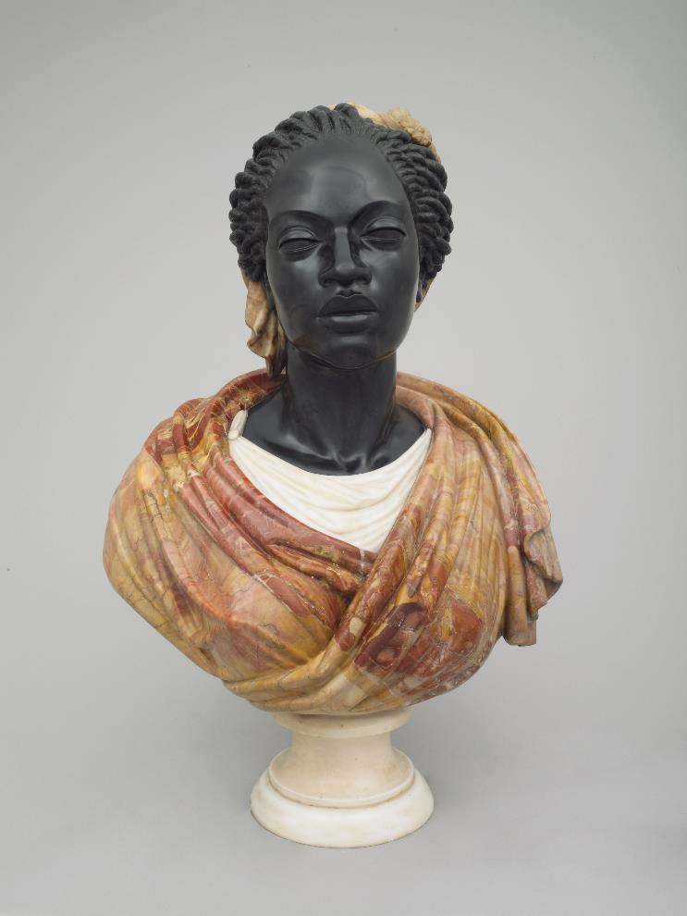
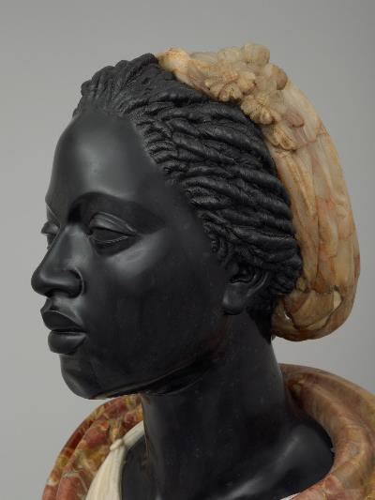
Title: Bust of an African Woman
Date: c. 1650
Size: 72 x 49.2 cm, depth 30.7 cm
Materials: Black, white and jasper marble
Artist: Unknown
Place: Italy, possibly Rome

Slide 31
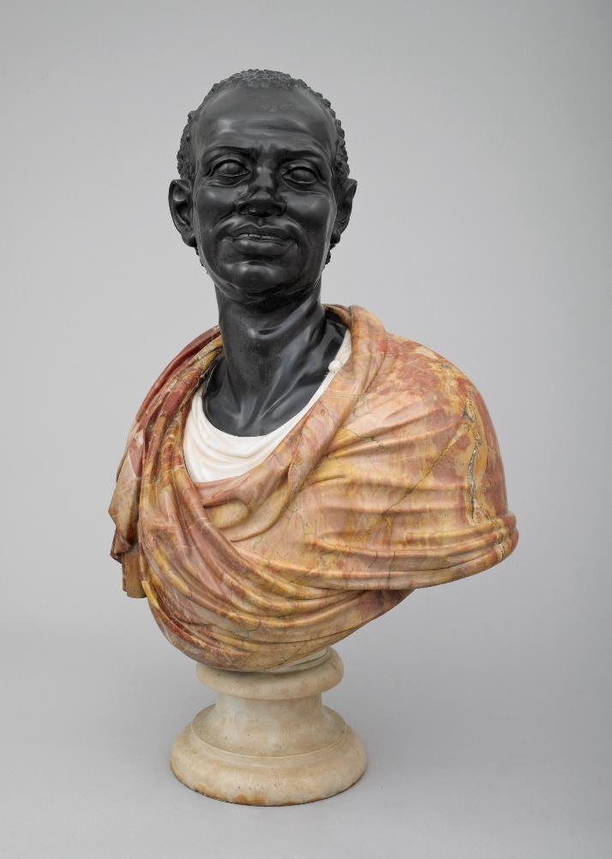
Unknown, Bust of an African Man, c. 1650

Slide 32
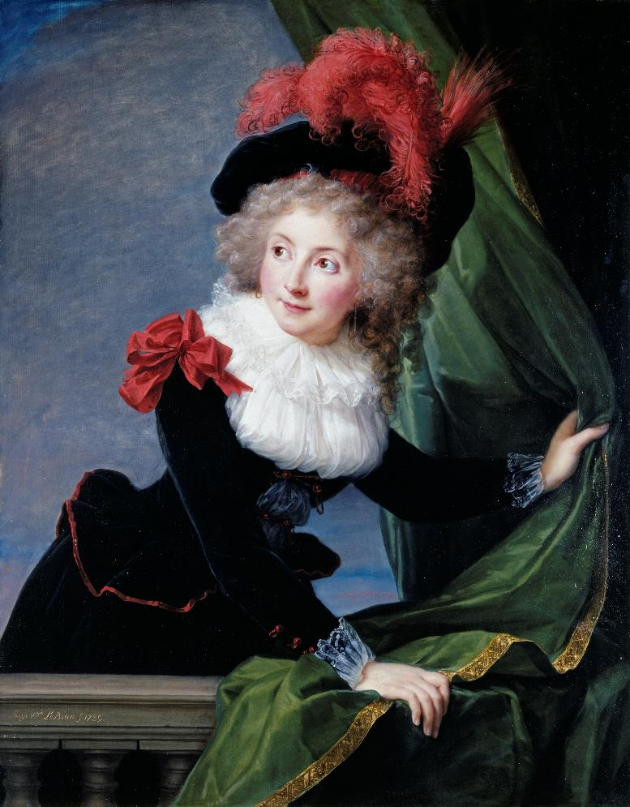
Title: Madame Perregaux
Date: 1789
Materials: Oil on oak panel
Size: 99.6 x 78.5 cm
Artist: Élisabeth-Louise Vigée Le Brun
Dates: 1755–1842
Place: France

Slide 33
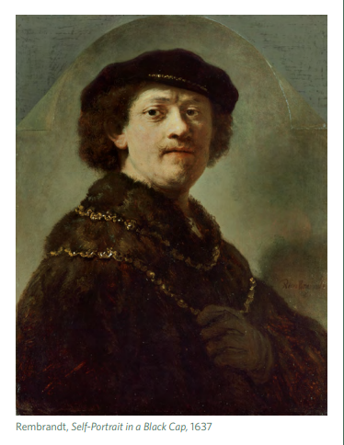
PORTRAITURE
SELF
KEY WORKS

Slide 34
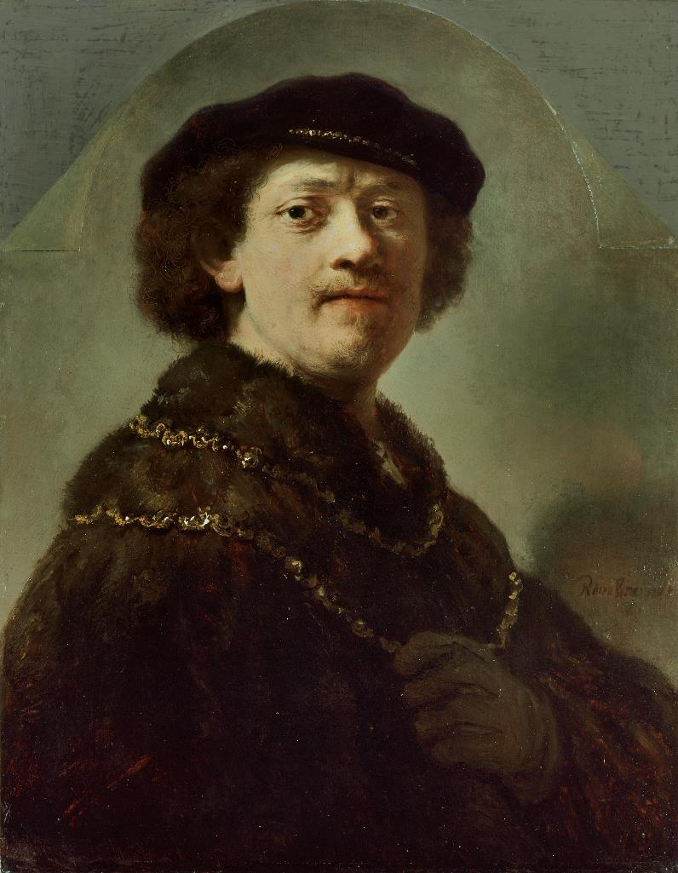
Self-Portrait in a Black Cap
Date: 1637
Size:63 x 50.7 cm
Materials: Oil on oak panel
Artist: Rembrandt ​
Dates: 1606–1669​
Place: The Netherlands

